Slide 1
Cloud Design Patterns
Ahmed Hesham

Slide 2
Cache Aside
Store frequently accessed data into a cache that is separate from a data store to improve performance

Slide 3
Issues To Consider
Lifetime of cached item
Cache eviction algorithm
Cold boots for cache
Consistency may not be guaranteed if a cache is external to the data store

Slide 4
Circuit Breaker
Faults can occur at anytime in a cloud application
It is important to not waste resources trying to perform actions that will fail
For example trying to connect a remote server and the connection is down
Circuit breaker acts as a Proxy between two entities

Slide 5
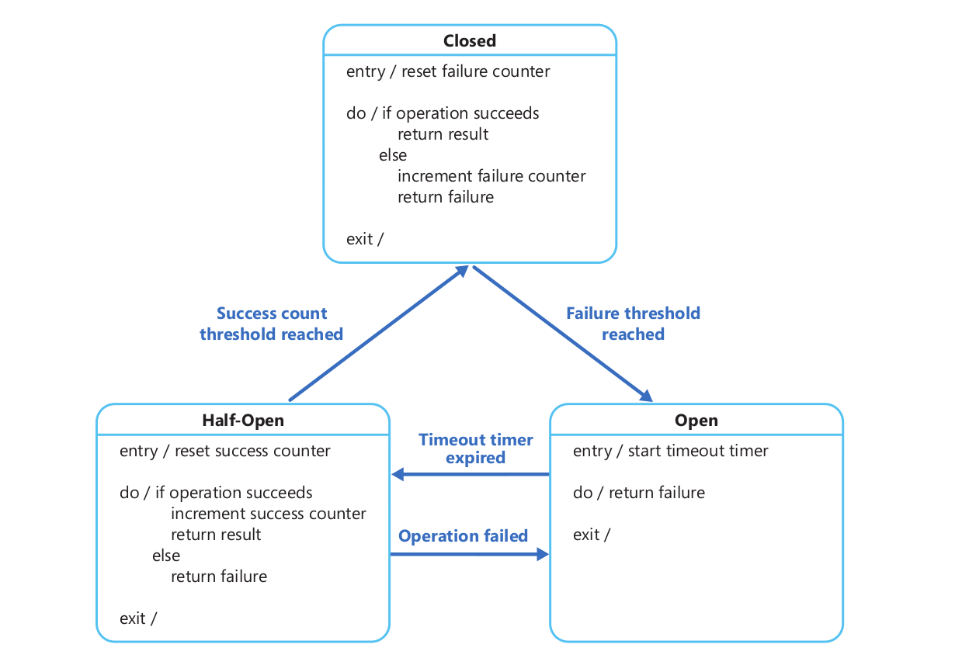
Circuit Breaker States

Slide 6
Issues To Consider
Concurrency: the same circuit breaker would be accessed by many instances of an entity, it should not block concurrent requests
Avoid using a single breaker on an entity that has providers, for instance in a distributed database, a node may be down but the rest are not

Slide 7
Issues To Consider – II
Accelerated Circuit Breaking: a response may contain enough information to trigger a break rather than wait for the counter
Manual Override: it is best to implement a manual override for the admin to utilize, to force open or close the circuit

Slide 8
Retry Pattern
Similar to Circuit Breaker, however Circuit Breaker assumes that the request will fail and therefore will deny further requests for a period of time, while Retry pattern will assume that the request will succeed if it is sent again
More suited for transient errors

Slide 9
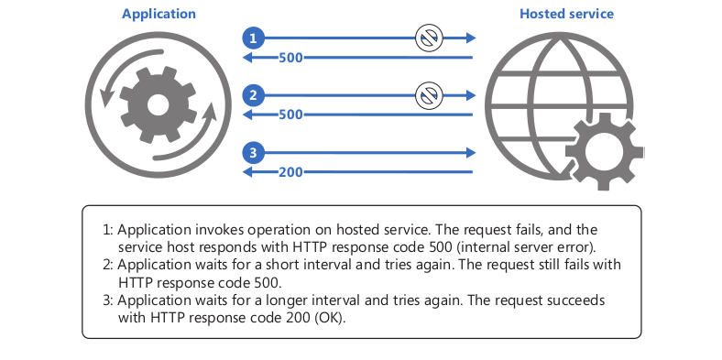

Slide 10
Issues To Consider
Short delayed repetitive retries on a server may degrade it, if it is running at maximum capacity
If a request still fails after a certain amount of retries it may be best to stop emitting the request, here the Circuit Breaker comes in handy

Slide 11
Competing Consumer
Enables multiple consumers to process messages sent on a shared channel concurrently
Avoids the use of a synchronous medium to process requests

Slide 12
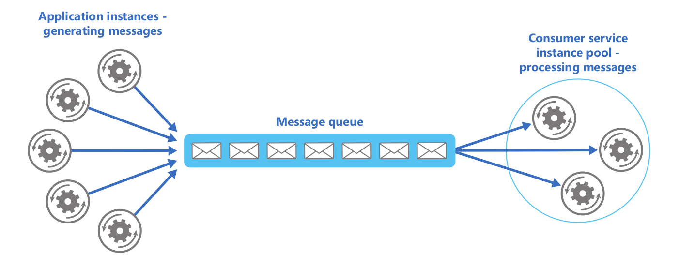

Slide 13
Compute Resource Consolidation
Following the micro-service architecture, an application will compromise of a set of small services
Grouping said services in one computational unit can reduce network overhead and running costs of the application

Slide 14
Issues To Consider
Not all services can be grouped together, it depends on their resource usage for instance:
  Grouping a database and a cache, would create a bottle neck in the system as all the requests would have to go to one unit
  Grouping a cache and a messaging queue would cause race conditions on the memory

Slide 15
External Configuration Store
Store the configuration of the application in to a centralized location for easier management

Slide 16
Gatekeeper (Ambassador)
Provides a Proxy for the clients to connect to, in order to provide a security layer
Proxy checks each incoming connection from the client and only allows trusted connections to pass through to the backend
It is important that the Gatekeeper does not have access to the keys used by the trusted host so that, if it is compromised, the attacker does not have access to the said keys

Slide 17
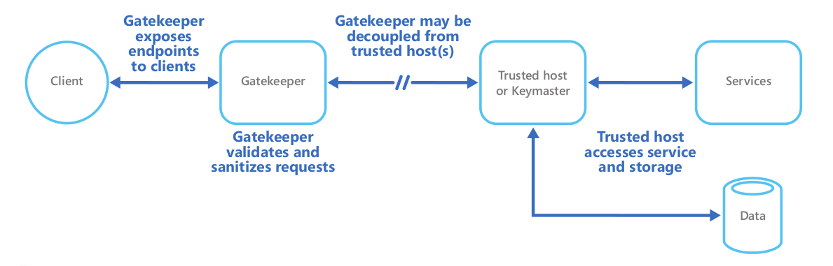

Slide 18
Issues To Consider
The Gatekeeper should have access only to protected APIs from the host
Gatekeeper must run in a limited privilege mode
Gatekeeper and the trusted host should run in separate environments, e.g. separate Vms for each
Gatekeepers could easily become a bottleneck in the system if not replicated enough
Connection between Gatekeeper and trusted host should be encrypted

Slide 19
Health Endpoint Monitoring
Provides an endpoint within an application so that external tools can verify the performance of the running application

Slide 20
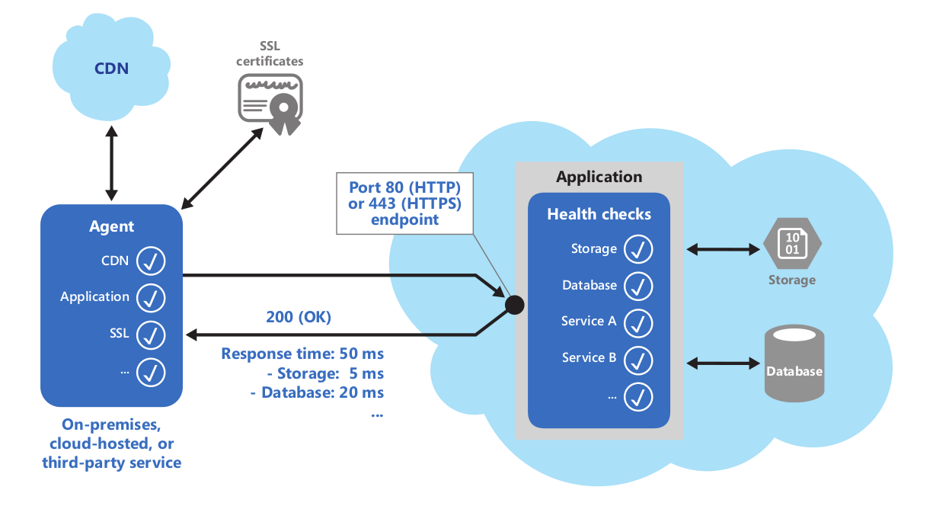

Slide 21
Issues To Consider
What would be an accepted response that will validate the health of the application
The number of endpoints to expose for health checks
How extensive the test should be to avoid the application failing

Slide 22
Pipes And Filters
Decompose applications into smaller applications (filters) that can be reused to form a pipeline of operations
Allows for flexibility in adding operations to business logic

Slide 23
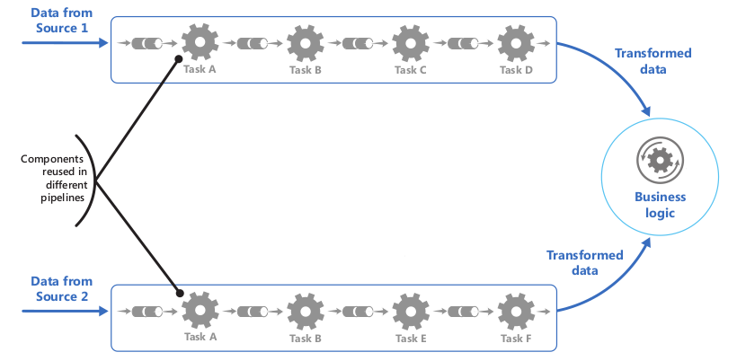

Slide 24
Issues To Consider
The speed of the pipeline depends on the slowest filter
Failure tolerance, if a filter fails, the tasks running on it should be rescheduled on another instance

Slide 25
Priority Queues
Priortize requests send to a service so that they are processed faster
Usually used in applications that offer different service levels to clients, such as premium and free users

Slide 26
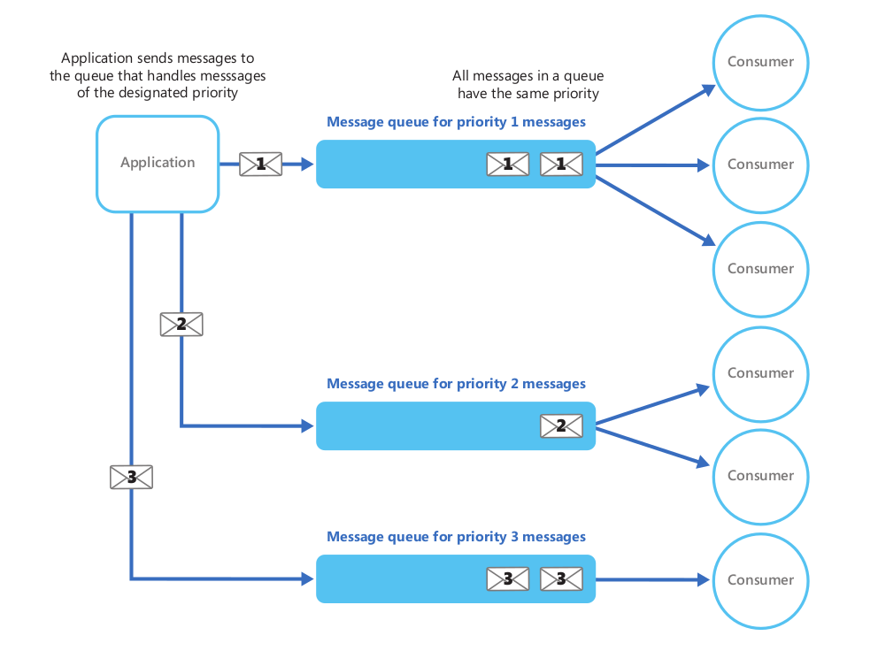

Slide 27
Issues To Consider
You may want to allocate more resources to higher priority requests
Using a separate queue for each message priority works best for a system with small number of pre-defined priorities

Slide 28
Runtime Reconfiguration
Applications are designed so that they can be reconfigured without reloading the application
Configuration files are written that define certain aspects of an application and are re-read on certain events, for example adding a new class, would append the class and the command it maps to in the file
Used where downtime is expensive

Slide 29
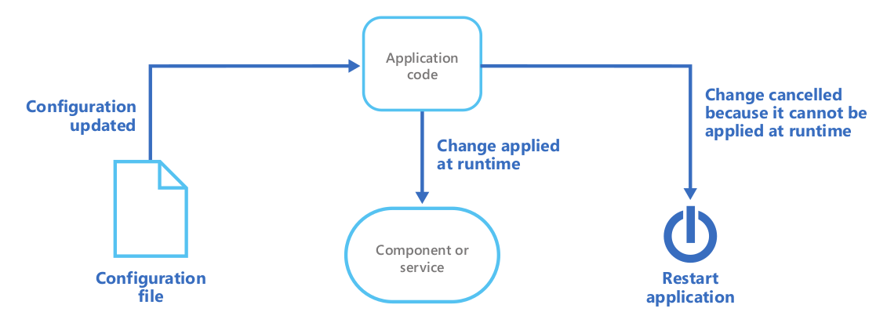

Slide 30
Issues To Consider
Changes should be applied dynamically while application is running
If the change cannot be applied dynamically, the application should handle restarting itself, either internally or by calling OS functions

Slide 31
Sharding
Data is divided across a set of horizontal partitions to serve more clients through the use of distributed resources, such as:
  Storage Space
  Computational Power
  Network Bandwidth
Allows for a more dynamic management of the data store, as now resources can be easily added to the cluster
Three main strategies are used to shard

Slide 32
Sharding – Lookup Strategy
A map is used to redirect requests to the correct shard containing the required data
In an application with multiple clients, the data per client may be stored on one shard
Shards can be shared with other clients

Slide 33
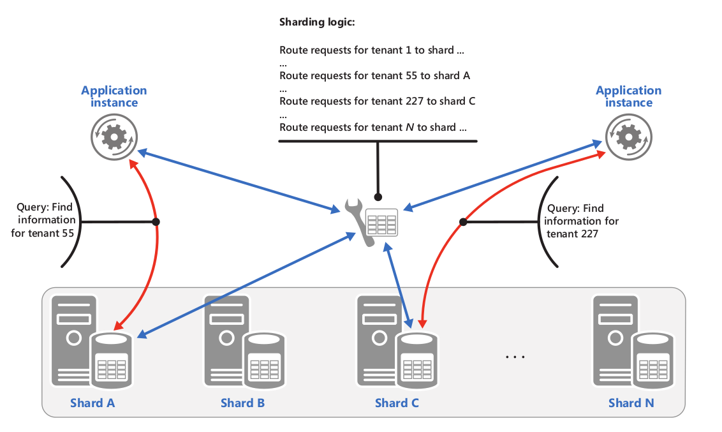

Slide 34
Sharding – Range Strategy
Groups related items in the same shard and orders them by the shard key (primary key in the shard)
More suited for applications that retrieve data using ranges, for example date ranges
A map is used to redirect requests

Slide 35
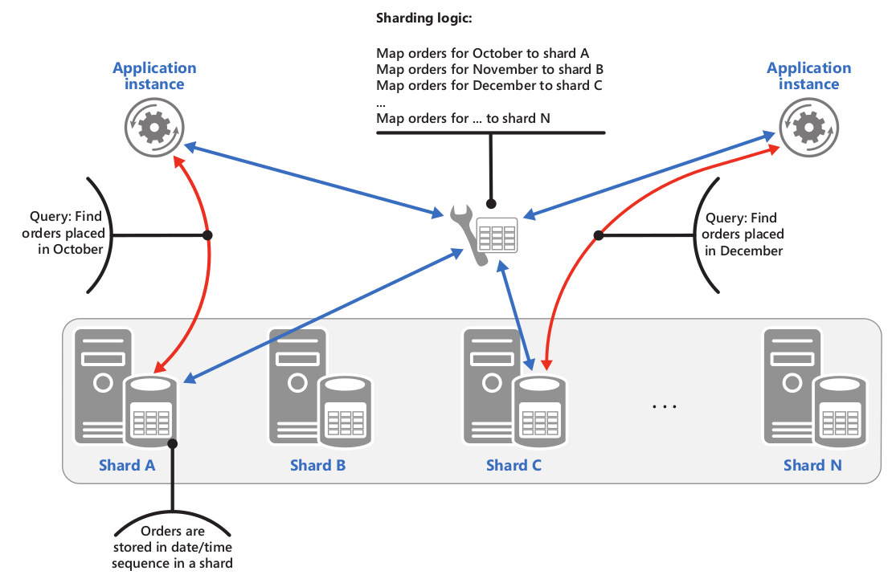

Slide 36
Sharding – Hashing Strategy
Tries to reduce hotspots by distributing the data across shards such that there is a balance between shard size and average load on shard

Slide 37
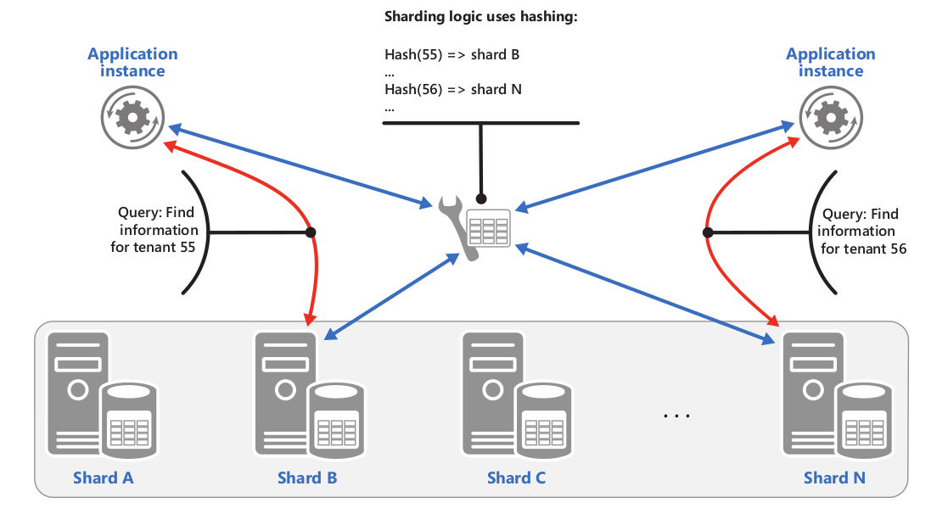

Slide 38
Issues To Consider
Avoid schemas in which queries have to run on multiple shards to retrieve data, it is not possible to entirely removed them however
Queries that have to run on multiple shards can be run in parallel
Avoid using auto incrementing keys as the shard keys as they may not coordinate well across shards and may result in key conflicts

Slide 39
Static Content Hosting
Static content are deployed on cloud based storage services rather than have them bundled with web servers
This frees up the web server to handle other requests

Slide 40
Issues To Consider
The storage service must offer an HTTP endpoint to service the files
The storage services must be secured to avoid anyone writing new content in them

